Slide 1



Mahmoud M. Awali @0xAwali
Sensitive Response
HTTP/1.1 200 OK
Content-Length: Number
Content-Type: application/json
{
"phone" : "01*********",
"token" : "*************"
}

Slide 2



My Methodology
attacker
Try To Inject Origin Header e.g. Origin: http://me.com And If Response Contains Access-Control -Allow-Origin: http://me.com AND Access-Control-Allow-Credentials: True , There is CORS
Writeup
GET /getInfo HTTP/1.1
Host: www.company.com
User-Agent: Mozilla/5.0
Referer: https://previous.com/path
Origin: http://me.com
Writeup
Writeup

Slide 3


My Methodology
attacker
Try To Inject Origin Header With Your Domain e.g. http://company.com.me.com , http://Acompany.com , http://companyAcom , http://company.comA And null To Get CORS
Video
GET /getInfo HTTP/1.1
Host: www.company.com
User-Agent: Mozilla/5.0
Referer: https://previous.com/path
Origin: http://company.com.me.com
Video
Tweet

Slide 4

My Methodology
attacker
Try To Inject Origin Header With Special Chars e.g. , & ' " ; ! $ ^ * ( ) + = ` ~ - _ = | { } % OR Non Printable Chars e.g. %01-08 , %0b , %0c , %0e , %0f , %10-%1f AND %7f
Blog
GET /getInfo HTTP/1.1
Host: www.company.com
User-Agent: Mozilla/5.0
Referer: https://previous.com/path
Origin: http://me.com`.company.com
Writeup

Slide 5

My Methodology
attacker
Try To Inject Origin Header e.g. Origin: http://me.com And If Response Contains Access-Control -Allow-Origin: * AND There Is Cache-Control: no-cache Header Try Use This POC
Writeup
<html>
<script>
var url = "https://www.company.com/getInfo";
fetch(url, {
method: 'GET',
cache: 'force-cache'
});
</script>
</html>
Blog
Tweet

Slide 6

My Methodology
attacker
Try To Use Web Cache Deception Attack , Add Static File e.g. nonexistent.css OR logo.png To Your Endpoint To Cache Sensitive Response
Slides
GET /getInfo/nonexistent.css HTTP/1.1
Host: www.company.com
User-Agent: Mozilla/5.0
Referer: https://previous.com/path
Origin: https://www.company.com
Writeup
Writeup
Writeup
Writeup

Slide 7
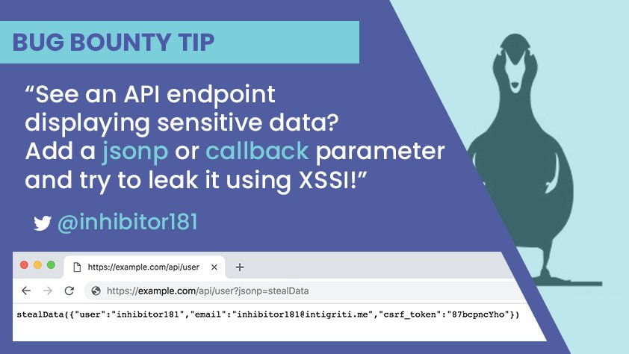
My Methodology
attacker
Try To Add jsonp OR callback To Any Sensitive Endpoints e.g. http://company.com/getInfo?jsonp=function To You Can Read The Response
Tweet
Writeup

Slide 8
My Methodology
attacker
Try To Figure Out , There Is Cache-Control: no-cache Header In HTTP/1.1 Response OR Pragma: no-cache Header In HTTP/1.0 Response , If Yes There Is Issue Here
Tweet
HTTP/1.1 200 OK
Content-Length: Number
Cache-Control: no-cache , no-store , must-revalidate
Content-Type: application/json
{
"phone" : "01*********",
"token" : "*************"
}

Slide 9
My Methodology
attacker
Try To Figure Out , There Is X-Frame-Option Header OR Not In The Response
Blog
HTTP/1.1 200 OK
Content-Length: Number
X-Frame-Option: SAMEORIGIN
Content-Type: application/json
{
"phone" : "01*********",
"token" : "*************"
}
Writeup
Writeup

Slide 10

My Methodology
attacker
There Are JSONP Endpoints OR JavaScript URL e.g. http://company.com/getInfo.js Contains Sensitive Data Based Only On Cookie , Try To Include It To Achieve XSSI
Slides
Steps to produce :-
1 - Filter Burp Suite History To MIME type Script 2 - Lookout For JS Endpoints Without
X-Content-Type-Options: nosniff
3 - Search About
Sensitive Data
4 - Make Sure There Isn’t Authorization Headers
Blog
Writeup

Slide 11

My Methodology
attacker
Try To Figure Out , There Is postMessage API e.g. Window.postMessage("text", "*"); OR addEventListener("message", function(message){message.origin});
Blog
Steps to produce :- 1 - Browse To http://company.com/getInfo
2 - Right Clicking , Click On View Page Source
3 - Search About
postMessage With * addEventListener With Argument-Function.origin
Blog
Blog
Blog
Blog

Slide 12
Mahmoud M. Awali @0xAwali
Thank You

